Slide 1


University Inventory Management System
This project aims to develop a streamlined inventory management system for university supplies, focusing on providing a convenient ordering process for university employees and ensuring proper approval and tracking of supplies.

Slide 2
Key Features
1
Simplify Ordering Process
2
Approval Workflow
Make it easy for university employees to browse, select, and order supplies.
Implement an approval workflow to ensure that all orders are reviewed and approved by the relevant authorities.
3
Tracking and Notifications
4
Inventory Management
Provide real-time tracking of order status and notifications to employees regarding their order approval and shipment status.
Keep track of the university's inventory, including stock levels and restocking requirements.

Slide 3




Streamlined Ordering Process
Request Supplies
University employees can easily submit supply requests through the system.
Approval Workflow
Requests are routed through the appropriate approval channels based on configurable rules.
Order Fulfillment
Approved requests are processed and the supplies are delivered to the requestor.

Slide 4
Integration with Existing Systems
Finance and Accounting
Seamless integration with the university's financial systems to manage budgets and expenditures.
HR and IT
Synced employee data to ensure accurate user permissions and access controls.

Slide 5
Implementation Plan and Timeline
Planning and Design
Pilot and Rollout
Gather requirements, design the system architecture, and develop the implementation plan.
Deploy the system in a pilot phase, gather feedback, and gradually expand it to all university departments.
1
2
3
Development and Testing
Build the inventory management system, including the web application, database, and integrations.

Slide 6


System Analysis
System analysis is the process of examining a business or organization to identify its goals, understand its operations, and determine how technology can best support those objectives. It's a crucial first step in developing effective software solutions.

Slide 7

Process Mapping
1
Current State
Document the existing workflows and procedures.
2
Identify Pain Points
Analyze the current process to find opportunities for improvement.
3
Future State
Design the desired future state, incorporating stakeholder feedback.

Slide 8
Problem Identification
Bottlenecks
Redundancies
Gaps
Pinpoint areas where the current process is inefficient or slow.
Identify duplicate tasks or data that can be streamlined.
Recognize missing functionality or information that users need.

Slide 9
Feasibility Study
Technical Feasibility
Economic Feasibility
Assess the technical requirements and capabilities needed to implement the solution.
Evaluate the costs and potential return on investment for the project.
Operational Feasibility
Schedule Feasibility
Determine if the organization has the resources and expertise to support the new system.
Establish a realistic timeline for the project's implementation and deployment.

Slide 10

Requirement Specification
Functional Requirements
Define the specific features and capabilities the system must have.
Non-Functional Requirements
Outline the performance, security, and usability standards the system must meet.
User Stories
Describe how users will interact with the system to accomplish their tasks.

Slide 11




Stakeholder Analysis
End Users
Management
IT Team
External Stakeholders
The individuals who will directly interact with the system.
The leaders who oversee the organization and set strategic goals.
The technical experts responsible for implementing and maintaining the system.
Partners, vendors, and other parties impacted by the system.

Slide 12
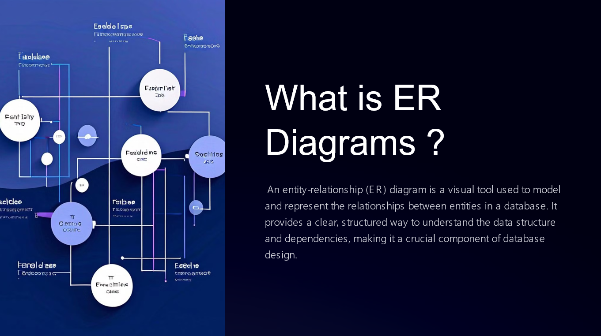

Slide 13
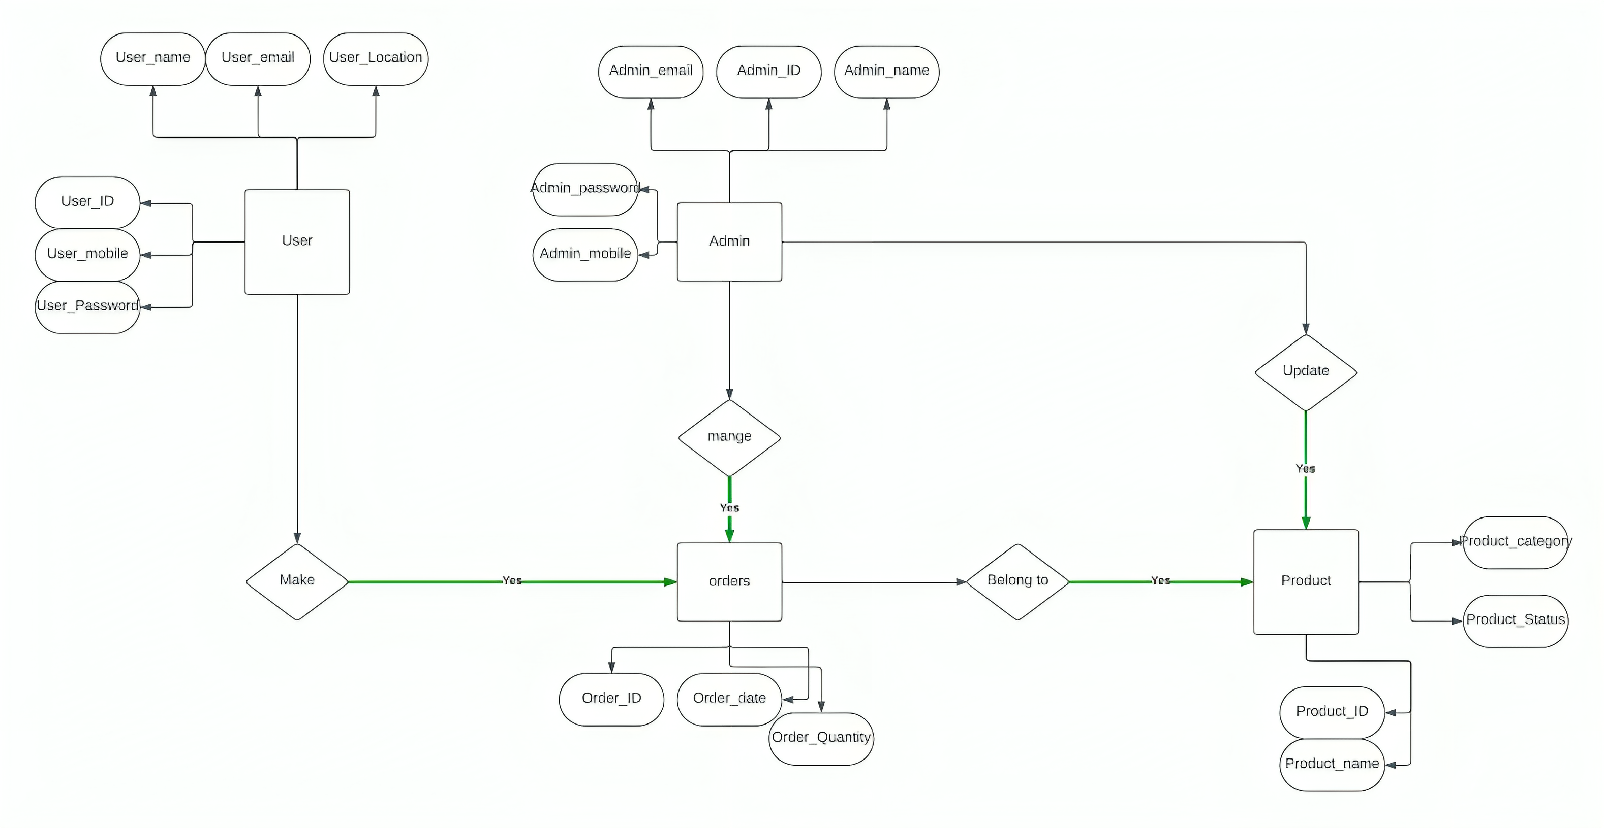

Slide 14
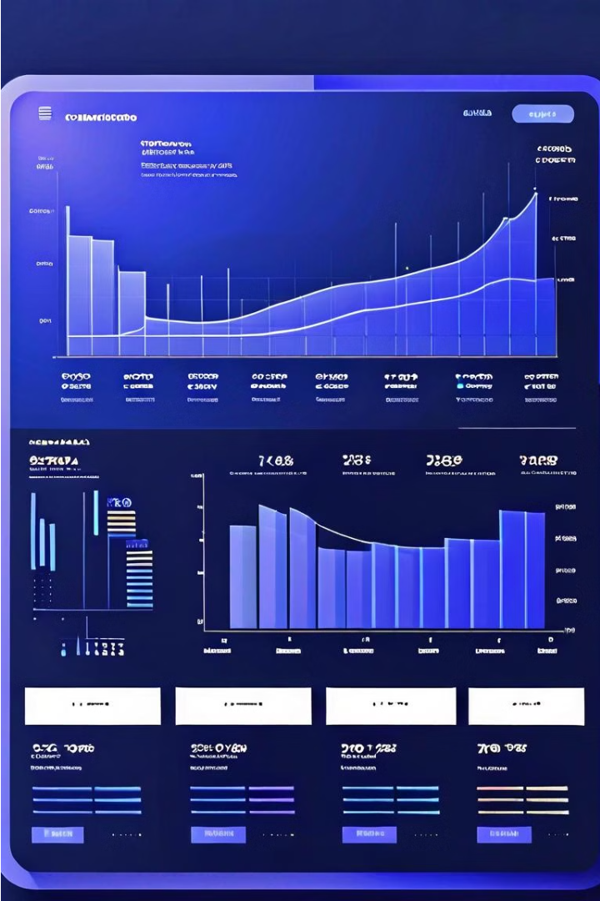
Frontend Inventory Management System
This presentation provides an overview of the frontend for an Inventory Management System. The frontend plays a crucial role in delivering an intuitive and user-friendly experience, empowering businesses to effectively manage their inventory through a seamless digital platform.

Slide 15

The Role of the Frontend
Intuitive UI
Data Visualization
Responsive Design
The frontend design focuses on creating an intuitive and easy-to-navigate user interface, ensuring a seamless experience for inventory managers.
The frontend incorporates data visualization tools to present inventory data in a clear and visually appealing manner, enabling informed decision-making.
The frontend is designed to be responsive, adapting to various device sizes and screen resolutions, providing a consistent experience across platforms.

Slide 16
React as the Front-end Technology
Component-based Architecture
Virtual DOM
Declarative Syntax
React's Virtual DOM feature enables efficient and optimized updates to the user interface, improving performance and responsiveness.
React's declarative syntax makes it easier to reason about the application's state and how it should be reflected in the UI.
React's component-based approach allows for the creation of modular and reusable UI elements, enhancing development efficiency and maintainability.

Slide 17
Integration with Backend Systems
Seamless Data Exchange
Secure API Integration
Scalable Infrastructure
The frontend seamlessly integrates with the backend systems, ensuring real-time data synchronization and a unified view of inventory data.
The frontend leverages secure API integrations to communicate with the backend, maintaining data integrity and privacy.
The frontend architecture is designed to be scalable, allowing the system to grow and adapt to changing business needs.

Slide 18




User Interface and User Experience Design
Intuitive Dashboard
Streamlined Navigation
Customizable Settings
Proactive Notifications
The frontend presents a centralized dashboard that provides a comprehensive overview of inventory data and key metrics.
The frontend offers a intuitive and efficient navigation system, enabling users to quickly access relevant inventory information.
The frontend allows users to personalize their experience by configuring various settings and preferences.
The frontend provides real-time alerts and notifications to keep users informed about critical inventory events.

Slide 19

Technology Stack
1
HTML, CSS, and JavaScript
2
Tailwind CSS
The frontend is built using the core web technologies of HTML, CSS, and JavaScript, ensuring a robust and standards-compliant foundation.
The frontend leverages the Tailwind CSS utility-first framework, enabling rapid and consistent styling of UI components.
3
React.js
The frontend is developed using the React.js library, which provides a flexible and efficient component-based architecture.

Slide 20
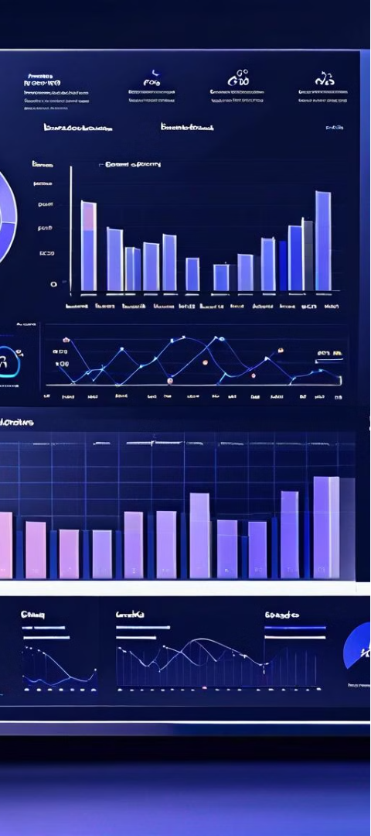
Data Visualization and Reporting
1
Inventory Reports
The frontend offers a range of pre-built and customizable reports, providing actionable insights into inventory trends and performance.
2
Real-time Analytics
The frontend integrates interactive data visualization tools, enabling users to analyze inventory data and identify optimization opportunities.
3
Forecasting and Projections
The frontend provides forecasting and projection capabilities, helping businesses anticipate future inventory demands and plan accordingly.

Slide 21
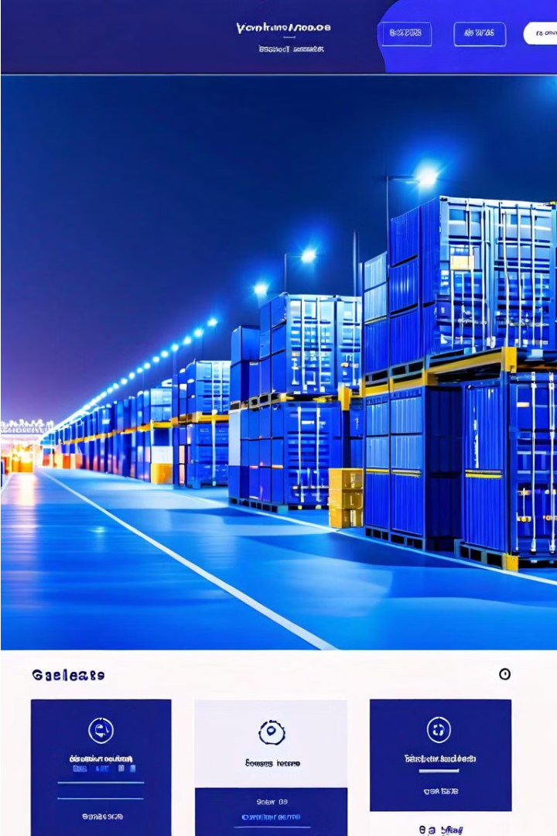
User Interface Design for Inventory Management
The user interface is the face of an inventory management system, and a well-designed UI can significantly impact the system's usability and adoption. A clean, responsive design ensures a seamless user experience across devices, enhancing productivity and overall satisfaction.

Slide 22
Login Interface
Secure Authentication
Intuitive Layout
The login interface should prioritize security with features like password encryption, two-factor authentication, and secure session management.
A simple, uncluttered login page with clear instructions and form fields can help users quickly and easily access the system.
Branding Consistency
Responsive Design
The login page should align with the overall branding of the inventory management system, reinforcing the company's identity.
The login interface should be designed to adapt seamlessly to different screen sizes, ensuring a smooth experience on any device.

Slide 23
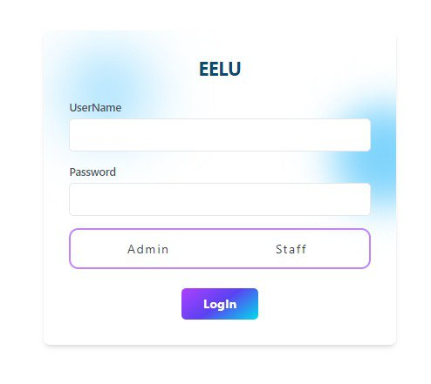

Slide 24


Sidebar Interface
Dashboard
Inventory
Orders
Users
Provides a comprehensive overview of the system's key metrics and performance indicators.
Allows users to manage and track product stocks, including adding, updating, and removing items.
Enables users to view, process, and fulfill customer orders efficiently.
Provides access to user management, including adding, editing, and assigning roles and permissions.

Slide 25
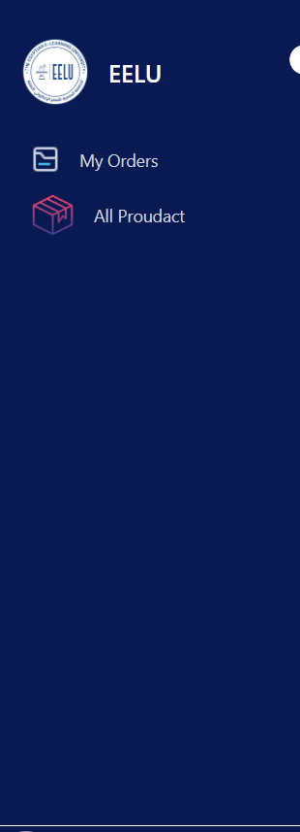
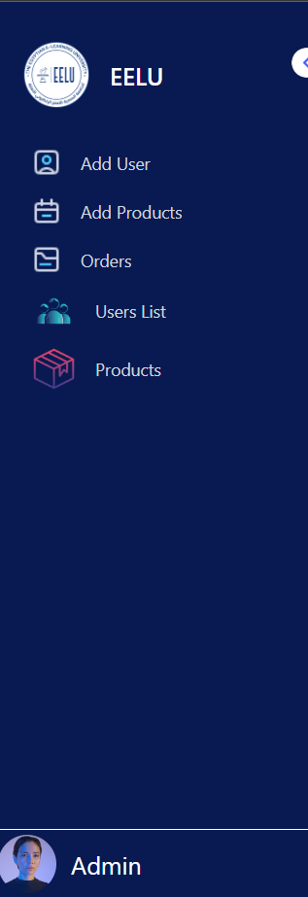

Slide 26
Add User Page
User Details
Permission Management
Intuitive Layout
The add user page should include form fields for capturing essential user information, such as name, email, and role.
This page should allow administrators to assign appropriate permissions and access levels to the new user, ensuring data security.
The page should have a clean, organized layout with clear instructions and visual cues to guide the user through the process.

Slide 27
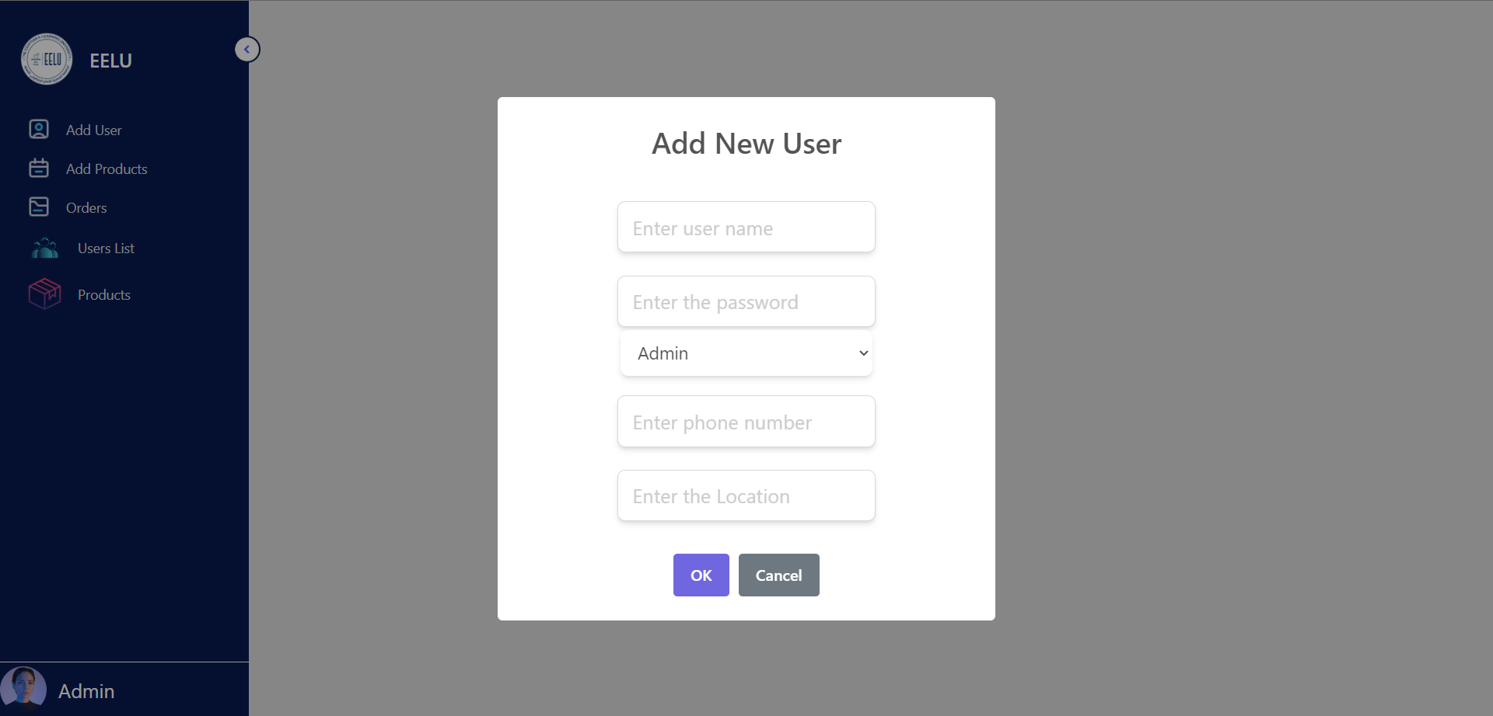

Slide 28

Add New Product Page
1
Product Information
Users should be able to input detailed product details, such as name, description, SKU, and price.
2
Inventory Management
The page should allow users to track and update product quantities, reorder levels, and other stock-related information.
3
Product Information
The ability to upload product information can enhance the system's visual appeal and User experience.

Slide 29
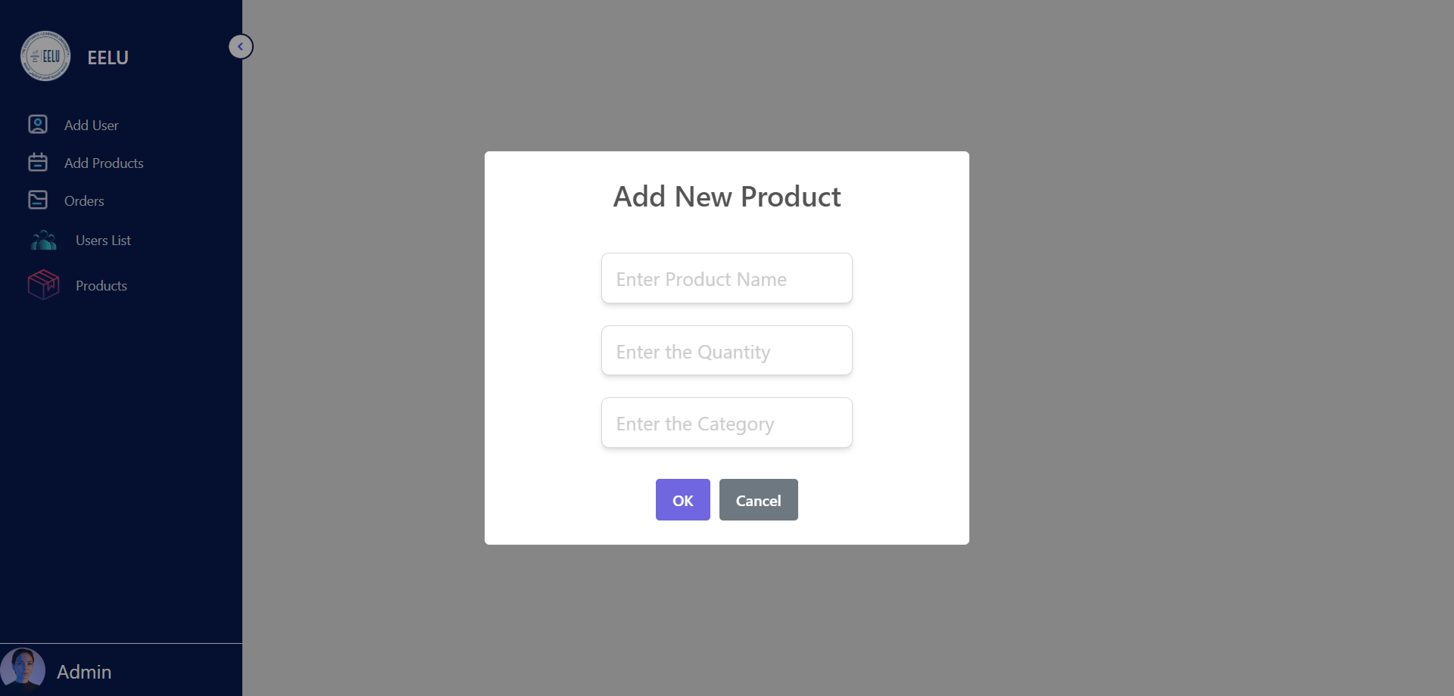

Slide 30



Order Management Page
Order Placement
Order Fulfillment
Order History
Users should be able to easily create new orders, including selecting products, quantities, and shipping details.
The page should provide tools to track order status, manage inventory, and efficiently ship products to customers.
A comprehensive order history section allows users to review past transactions and generate reports.

Slide 31
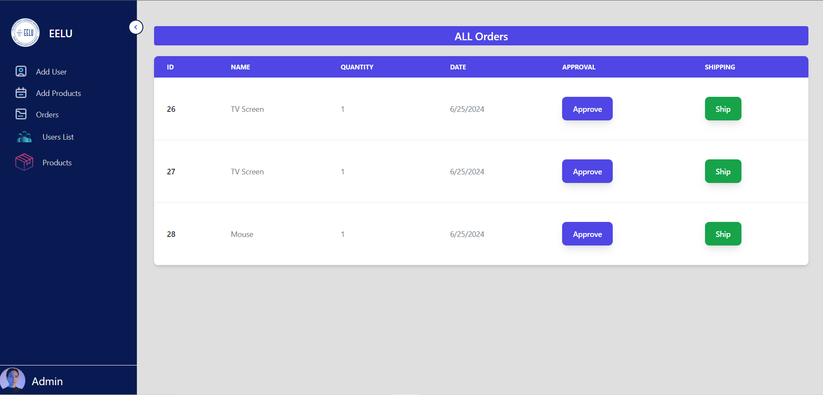

Slide 32
All users
It shows users with usage rules and all their information

Slide 33
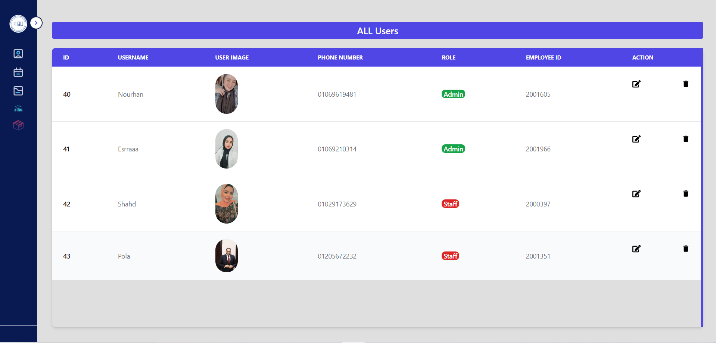

Slide 34

Backend Inventory Management System
The backend of an inventory management system plays a crucial role in efficiently storing, organizing, and processing data. It provides the foundation for seamless data management, enabling businesses to track and monitor their inventory levels, sales, and supply chain operations.

Slide 35
Role of Backend in Data Management
Data Storage
Data Processing
Data Accessibility
The backend is responsible for securely storing and managing all inventory-related data, including product information, stock levels, and transaction histories.
The backend handles the processing and analysis of data, enabling businesses to generate reports, make informed decisions, and optimize their inventory management strategies.
The backend provides a centralized platform for accessing and updating inventory data, ensuring that all authorized users can access the information they need in real-time.

Slide 36

Importance of Business Logic Execution
1
Automated Workflows
2
Data-Driven Insights
The backend executes key business logic, such as automated reordering, stock alerts, and inventory replenishment, streamlining operations and reducing manual intervention.
By applying complex algorithms and analytics, the backend generates valuable insights that help businesses make informed decisions and optimize their inventory management strategies.
3
Compliance and Regulations
The backend ensures adherence to industry regulations and internal policies, maintaining data integrity and supporting legal and financial reporting requirements.

Slide 37



Overview of Python and Django for Backend
Python
Django
Database Integration
API Development
A powerful, versatile, and widely-used programming language that excels in backend development, data analysis, and automation.
A popular Python web framework that provides a comprehensive set of tools and features for building robust and scalable backend applications.
Django's capabilities extend to building RESTful APIs, enabling seamless communication between the backend and other components of the system.
Django's built-in ORM (Object-Relational Mapping) simplifies database interactions and allows for seamless integration with various database systems.

Slide 38
Data Models and Database Integration
Data Modeling
Schema Migrations
Django's powerful ORM allows developers to define data models that accurately represent the inventory management system's entities and relationships.
Django's migration system streamlines the process of updating the database schema as the application evolves, ensuring data integrity and minimizing downtime.
1
2
3
Database Integration
The backend seamlessly integrates with various database systems, such as PostgreSQL, MySQL, or SQLite, ensuring reliable data storage and retrieval.

Slide 39




API Development and RESTful Endpoints
API Design
The backend team designs and implements a robust API that exposes the inventory management system's functionality to other components or external applications.
RESTful Endpoints
The backend leverages Django's built-in support for creating RESTful APIs, ensuring seamless communication and data exchange with the frontend and other systems.
Authentication and Authorization
The backend handles user authentication and authorization, ensuring secure access to the inventory management system's data and functionality.

Slide 40
Authentication and Authorization Mechanisms
Authentication
Secure user login, password management, and session handling to verify the identity of users accessing the system.
Authorization
Granular control over user permissions, allowing different levels of access and functionality based on user roles and privileges.
Token-based Authentication
The use of JSON Web Tokens (JWT) or similar mechanisms to securely authenticate and authorize users, enabling seamless integration with external systems.

Slide 41

Backend and API Inventory Management System
The backend plays a crucial role in inventory management systems, managing data, executing business logic, and facilitating seamless communication between the frontend and the database through a RESTful API.

Slide 42
Role of API in the Backend with Python Django
Data Management
Business Logic
Communication
The backend uses Django's ORM to interact with the database, storing and retrieving inventory data efficiently.
The backend encapsulates the core functionality of the inventory system, such as order processing and fulfillment.
The RESTful API provides a standardized interface for the frontend to communicate with the backend, ensuring seamless data exchange.

Slide 43
Seamless Communication with RESTful API
Frontend
RESTful API
Backend
The frontend application communicates with the backend through the RESTful API.
The API provides a standardized interface for the frontend to access and manipulate inventory data.
The backend processes requests from the frontend, executes business logic, and updates the database accordingly.

Slide 44
Endpoints in the API with Examples
GET /products
Retrieve a list of all products in the inventory
POST /orders
Create a new order and update the inventory accordingly
PUT /orders/{id}
Update the status of an existing order
DELETE /products/{id}
Remove a product from the inventory

Slide 45



Order Processing and Fulfillment
Order Placement
Inventory Check
Order Fulfillment
User Support
Customers can place orders through the frontend application.
The backend verifies product availability and updates the inventory accordingly.
The backend coordinates the shipping and delivery of the ordered items.
The backend provides customer support functionalities, such as order tracking and returns.

Slide 46
Authorization Rules and User Roles
Admin
Warehouse Manager
Administrators can access all functionalities, including inventory management, order processing, and user management.
Warehouse managers can view and update inventory levels, process orders, and manage shipping.
User
Guest
User can view product information, place orders, and track the status of their orders.
Guests can only view publicly available product information and cannot access any sensitive data or functionalities.

Slide 47
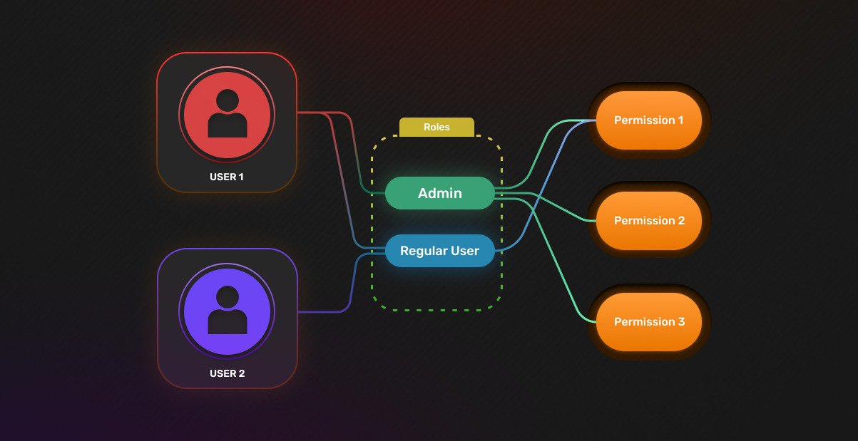

Slide 48


